Slide 1

Electricity Consumption Using Time Series Analysis
Vanshika Gupta, Dev Raj, Rishitha Pamu, Shruti Wadatkar
Data Science and Engineering, IISER Bhopal

Slide 2
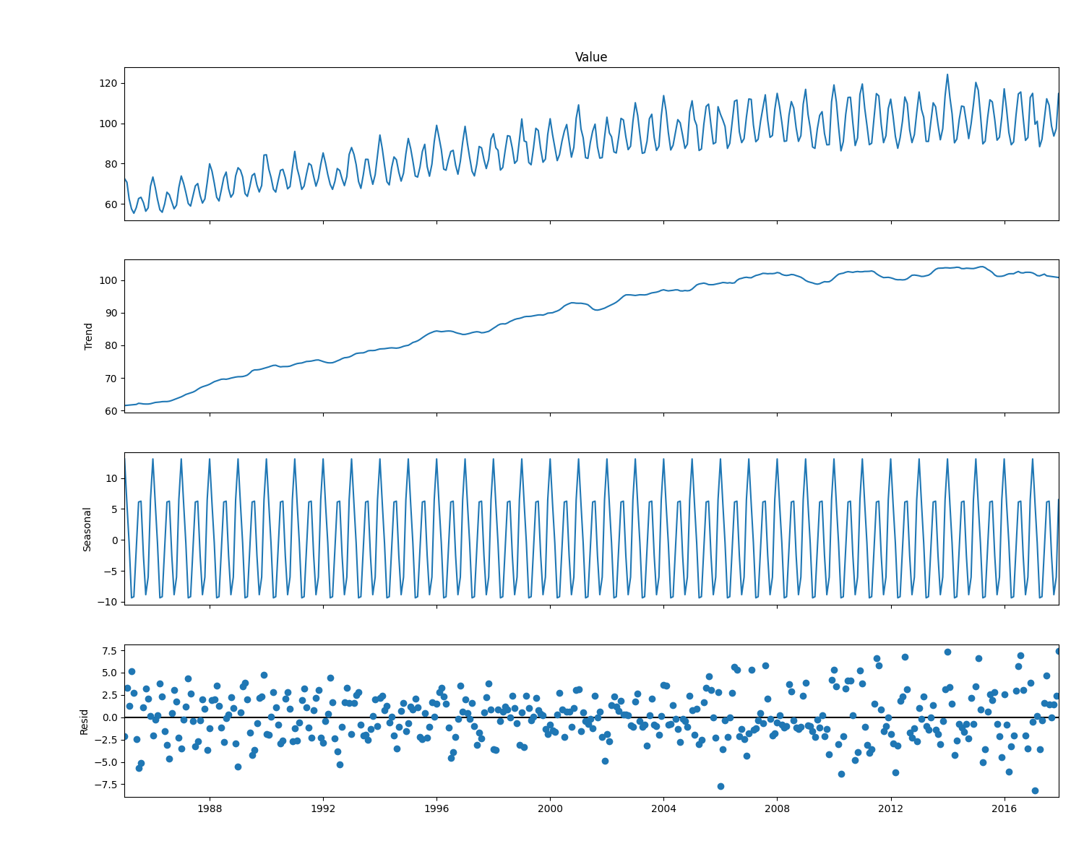
Understanding the Data
Our Data: Key Features
The dataset is a univariate time series (one variable over time). We found two key patterns:
•
It has a clear upward trend (consumption is increasing over the years).
•
It has strong seasonality (a repeating pattern of peaks and valleys each year).
We use additive decomposition to visually separate these components.

Slide 3
Understanding the Data
Our Data: Key Features
The dataset is a univariate time series (one variable over time). We found two key patterns:
•
It has a clear upward trend (consumption is increasing over the years).
•
It has strong seasonality (a repeating pattern of peaks and valleys each year).
We use additive decomposition to visually separate these components.

Slide 4



Our Models
SARIMA & GARCH
ETS (Holt-Winters)
Prophet
LSTM
Statistical models for linear patterns and residual volatility.
Explicitly models level, trend, and seasonality using smoothing.
A fast, interpretable, and component-based additive model, developed by Facebook.
A deep learning model for complex, non-linear patterns.

Slide 5
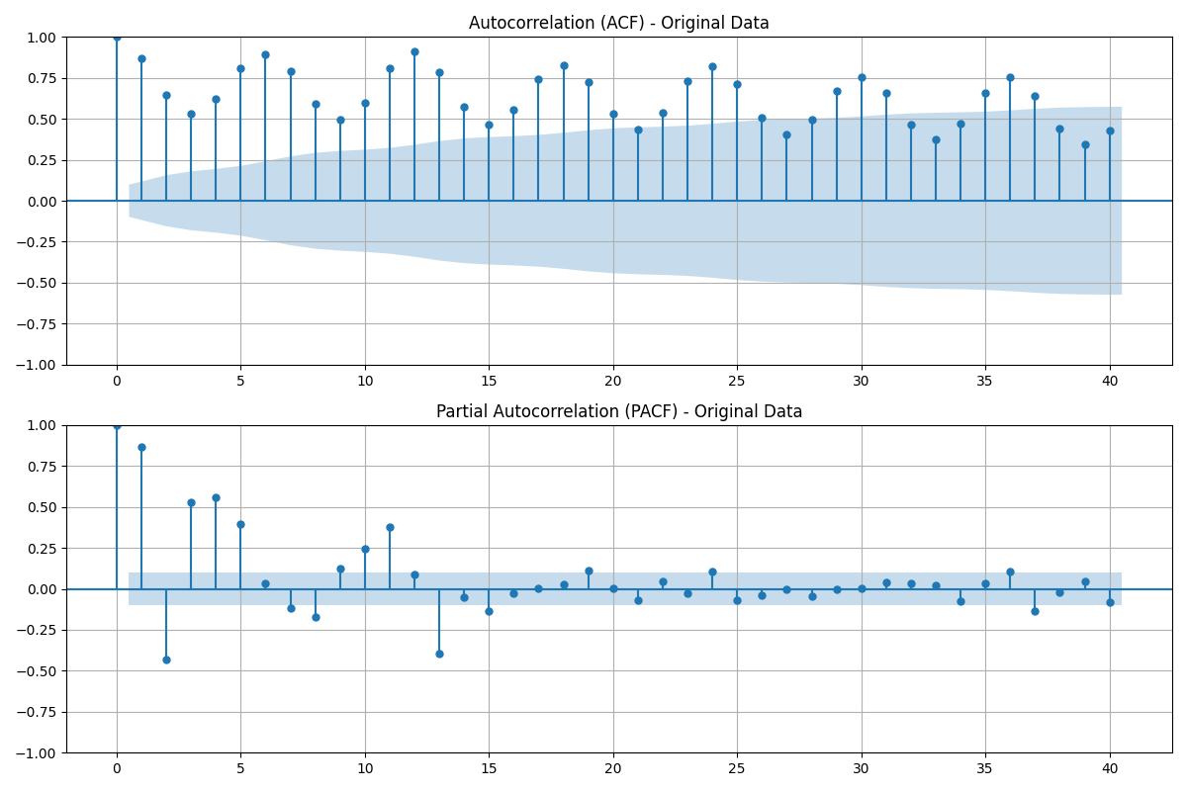
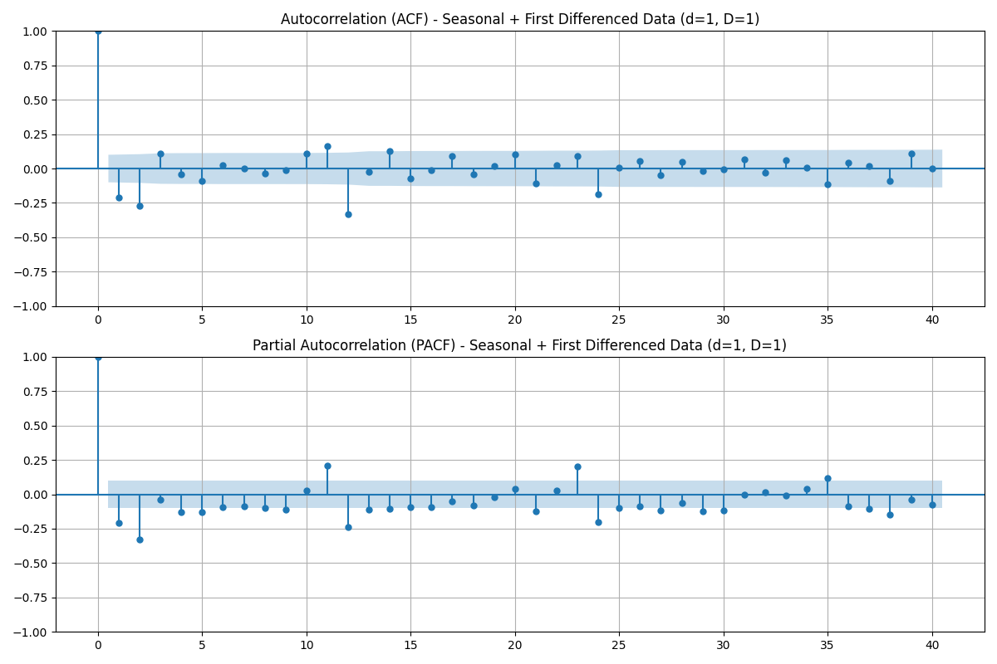
Workflow: SARIMA
Step 1: Achieve Stationarity
SARIMA requires stationary data (a constant mean and variance).
1.
The original data was non-stationary (due to the trend).
2.
We applied seasonal (D=1) and first (d=1) differencing to stabilize it.
3.
We used these ACF/PACF plots on the differenced data to confirm stationarity and find SARIMA Model.

Slide 6
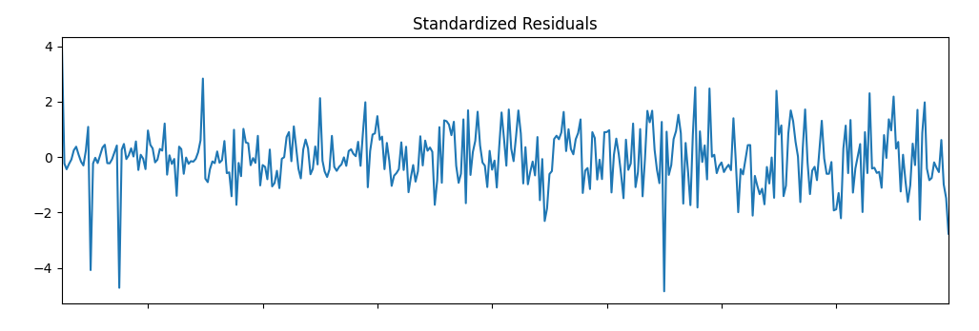
Workflow: GARCH
Step 2: Model Volatility
After fitting SARIMA, we checked its residuals (the errors).
Finding: The residuals showed volatility clustering. This means periods of high error and low error were clumped together.
Solution: We added a GARCH model to specifically model this non-constant variance.

Slide 7

Workflow: ETS
For a simple ETS model, the level component is updated as:
where:
α= smoothing parameter for the level (between 0 and 1),
yt​ = the observed value at time ttt,
l(t−1​ )= previous level estimate,
b(t−1)​ = previous trend estimate.
Step 3:decompose a time series into Error(E) , Trend (T) ,Seasonality (S)
ETS serves as a classical benchmark before testing Prophet, SARIMA, or LSTM.​ It shows how much improvement you gain with advanced models.​
Implements Exponential Smoothing forecasting model.​
Exponential smoothing is used to generate forecasts
.

Slide 8

Workflow: PROPHET
A generalized additive model (GAM)
It is designed to make it easy for both non-experts and experienced practitioners to generate reliable forecasts, especially when dealing with data that exhibits strong seasonal effects and multiple seasonalities, along with trend changes
Where:
y(t)y(t)y(t) = observed value at time ttt
g(t)g(t)g(t) = trend function
s(t)s(t)s(t) = seasonality component
h(t)h(t)h(t) = effects of holidays or special events
ϵt∼N(0,σ2)\epsilon_t \sim \mathcal{N}(0, \sigma^2)ϵt​∼N(0,σ2) = error term
.

Slide 9
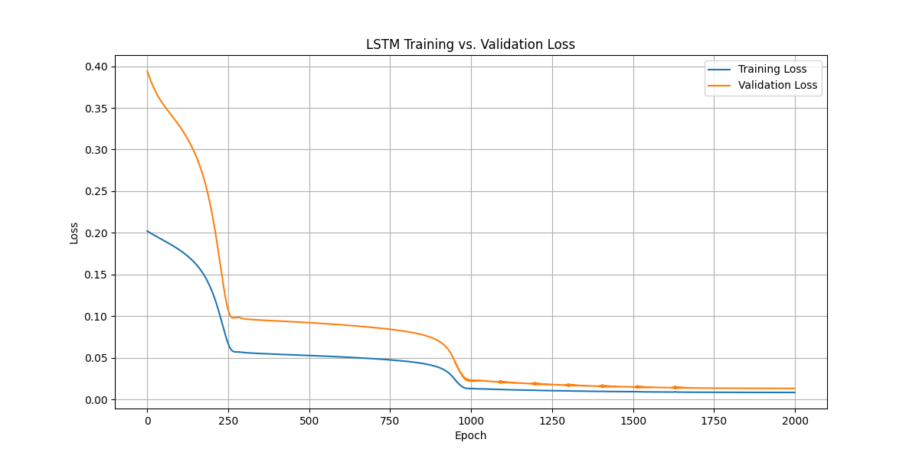
Workflow: Building the LSTM
A Deep Learning Approach
The LSTM is a 'black box' model that learns patterns automatically.
Data was scaled (normalized) and transformed into sequential 'windows' (e.g., use 12 months to predict the 13th).
The model was trained to predict the next time step from a window of past steps.
We monitored training and validation loss to prevent overfitting.

Slide 10
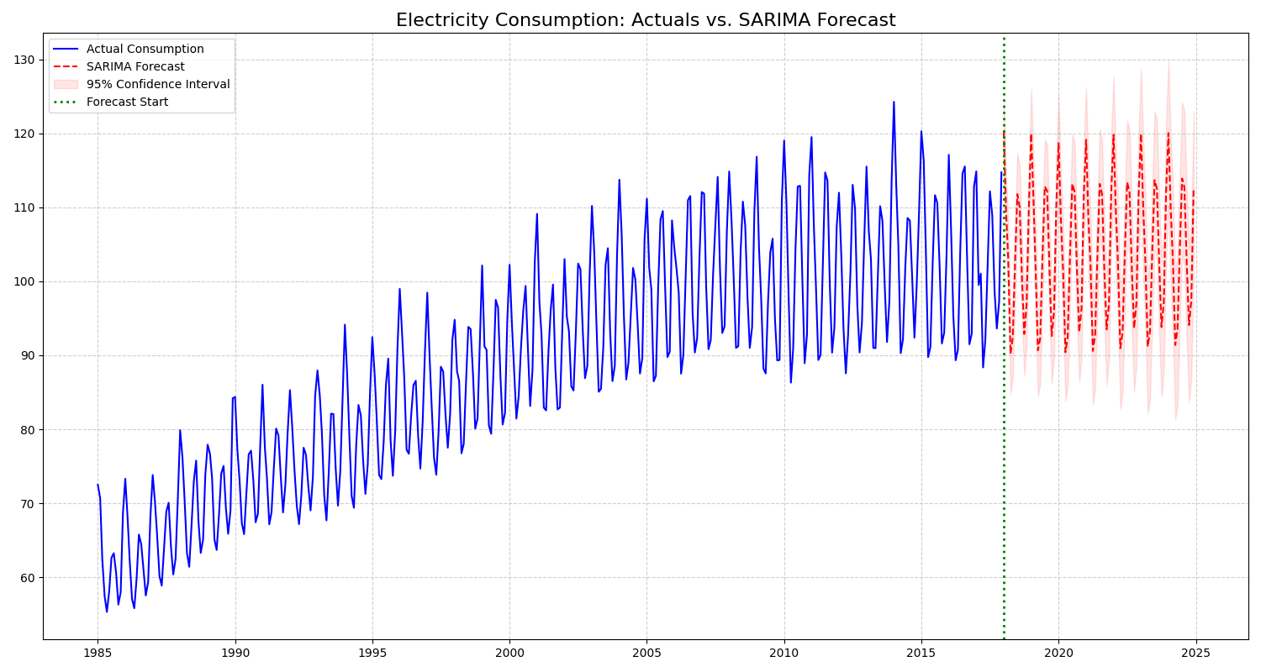
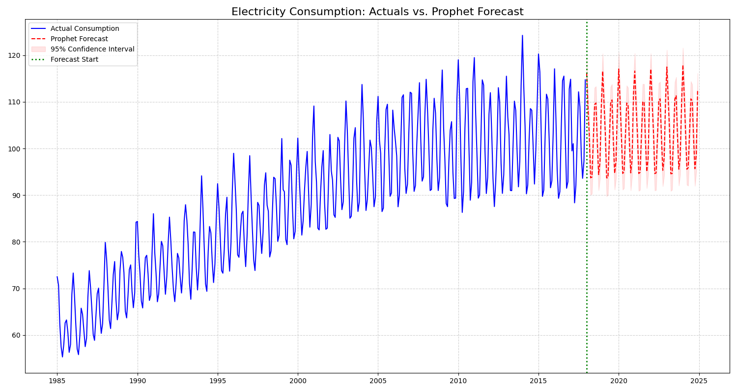
Results:
SARIMA Forecast
Prophet Forecast
Captures the trend and seasonality well.
Also follows the main patterns effectively.

Slide 11
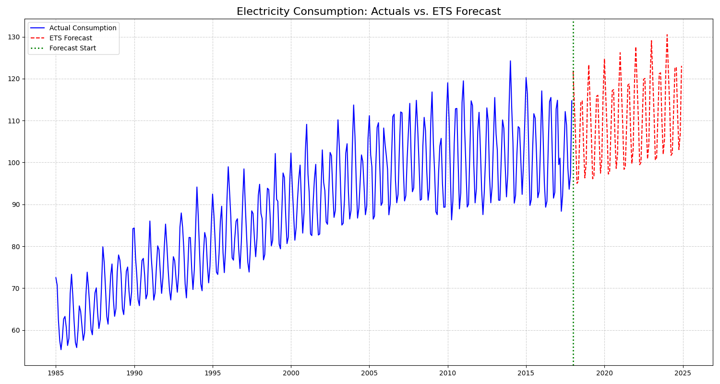
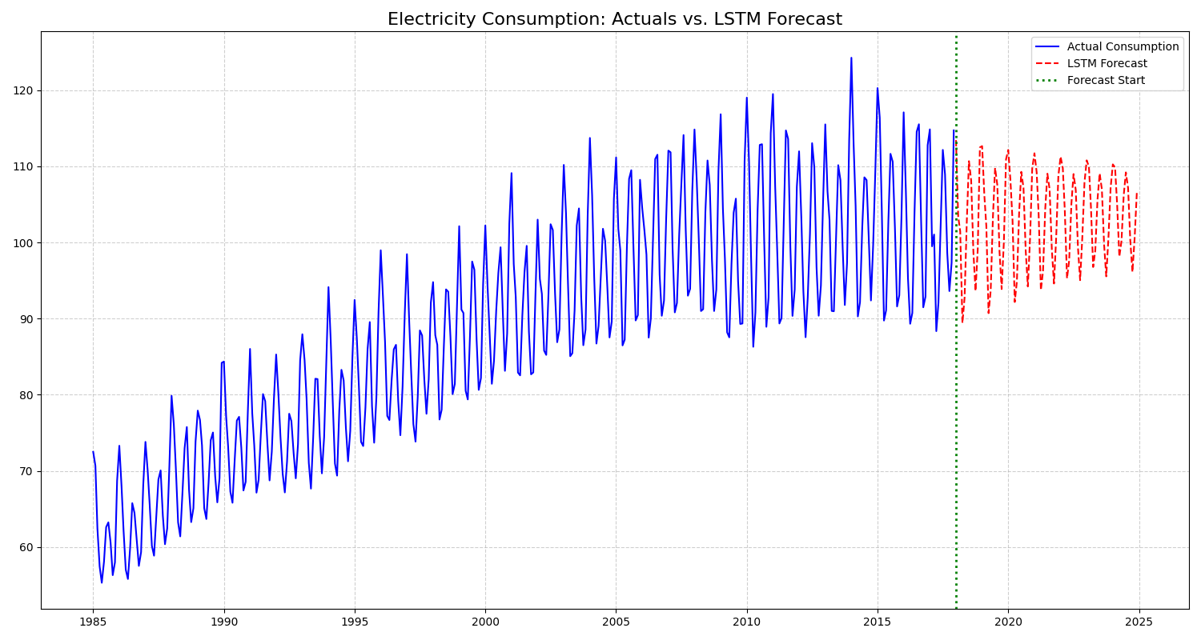
Results:
ETS (Holt-Winters) Forecast
LSTM Forecast
A classic statistical fit.
The deep learning model's fit.

Slide 12
Quantitative Results:
We compared all models on a held-out test set. Lower scores are better.
Model | MAE (Avg. Error) | RMSE (Penalizes Big Errors) | MAPE (Avg. % Error)
SARIMA | 2.4351 | 3.2875 | 2.36%
ETS (Holt-Winters) | 4.0925 | 4.8860 | 3.89%
Prophet | 3.4321 | 4.1965 | 3.43%
LSTM | 3.3808 | 2.6463 | 2.61%

Slide 13


Discussion: The Trade-Off
Best Accuracy
Best Interpretability
SARIMA: Had the lowest *average error* (MAE & MAPE). A fantastic, interpretable baseline for this dataset.
PROPHET: While not the most accurate here, its strength is *speed and interpretability*. You can easily plot its components (trend, seasonality) to see *why* it made its forecast.
LSTM: Had the lowest *RMSE*. This suggests it was the best at avoiding large, costly errors, likely by capturing non-linear patterns.
ETS: A clear, simple statistical competitor, but it was less effective *on this specific dataset* than the more complex SARIMA.

Slide 14
Conclusion
Successfully compared four models, from statistical to deep learning.
The "best" model depends on the goal: Accuracy (SARIMA/LSTM) vs. Interpretability (Prophet).
Future Work
Hybrid Models: Combine SARIMA (for linear patterns) with an LSTM (for non-linear residuals).
Multivariate Analysis: Add other variables (e.g., weather, holidays) using VAR or multivariate LSTMs.
Probabilistic Forecasting: Quantify the *uncertainty* of the forecasts, not just a single-point prediction.

Slide 15
Questions?
Thank You

